Slide 1
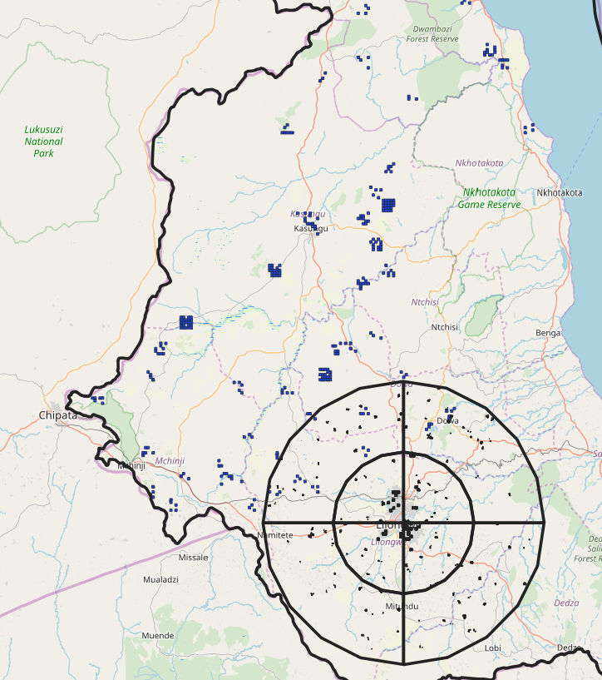
Introduction to Geospatial Data
A short course
Spring 2020
Erica A. Metheney

Slide 2
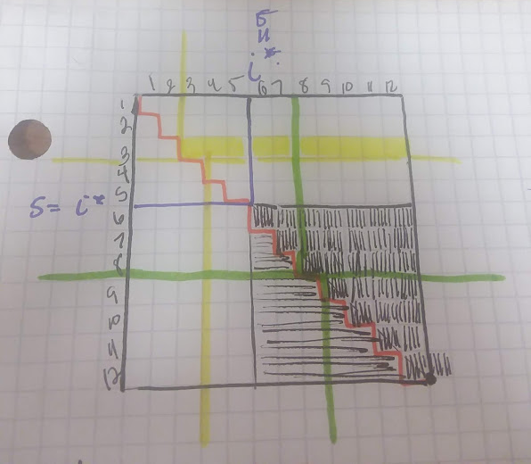
Erica Ann Metheney, PHD

Slide 3
What we will learn
The difference between geographic, spatial, and geospatial data.
The importance of choosing appropriate coordinate reference systems (CRS)
About various types of geographic and geospatial data types.

Slide 4
References
GIS and Spatial Analysis for the Social Sciences: Coding, Mapping, and Modeling. Robert Nash Parker, Emily K. Asencio. Routledge, 2009. ISBN 1135857598.
Not specifically QGIS, but the generally prinicples apply.
Geocomputation with R. Robin Lovelace, Jakub Nowosad, Jannes Muenchow. CRC Press, 2019. ISBN 1351396900.
Chapters 2 – 6 will be most helpful with getting started.
Learning Geospatial Analysis with Python. Joel Lawhead. Packt Publishing Ltd, 2013. ISBN 1783281146.

Slide 5
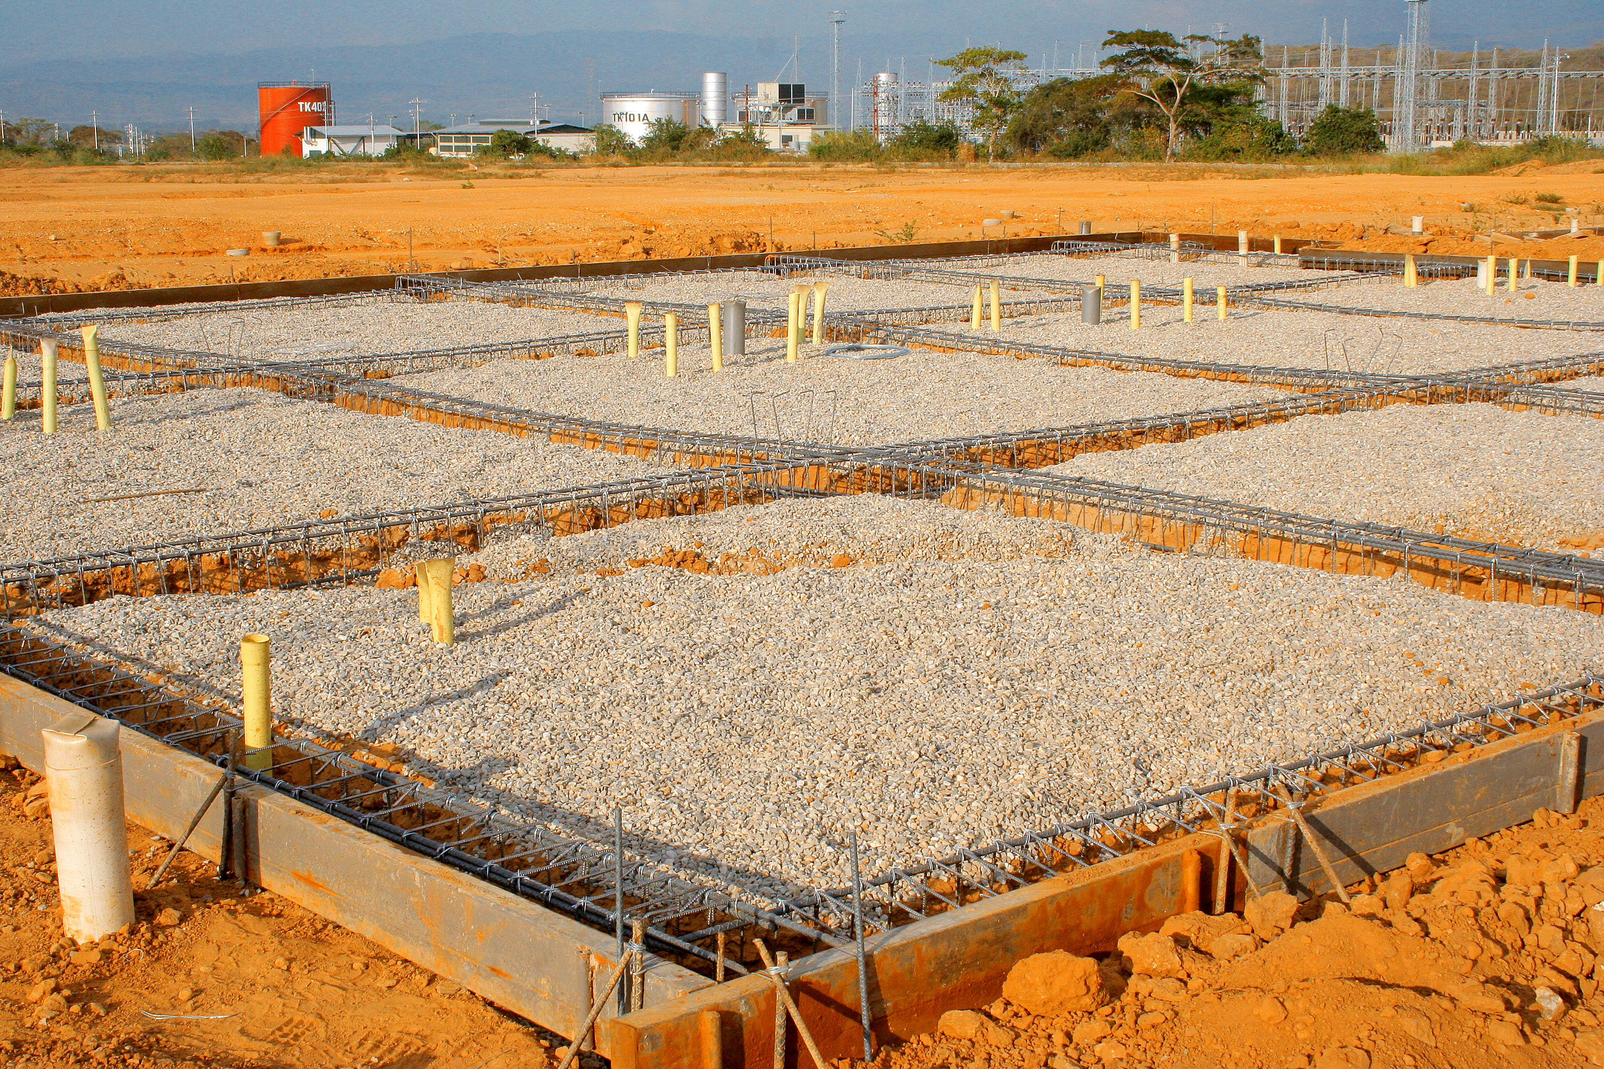
Build A Foundation
Establish Terminology
Maps as Models
Data Types
Files Types
Data Sources

Slide 6
Terminology
QUESTION
What is the difference between:
Geographic Data?
Spatial Data?
Geospatial Data?

Slide 7
Terminology
QUESTION
What is the difference between:
Geographic Data?
Spatial Data?
Geospatial Data?
Geographic Data – provides information about location

Slide 8
Terminology
QUESTION
What is the difference between:
Geographic Data?
Spatial Data?
Geospatial Data?
Geographic Data – provides information about location
Spatial Data – data collected over any generic space

Slide 9
Terminology
QUESTION
What is the difference between:
Geographic Data?
Spatial Data?
Geospatial Data?
Geographic Data – provides information about location
Spatial Data – data collected over any generic space
Geospatial Data – data collected over across the surface of the earth

Slide 10
CLASSIFY EACH OF THE FOLLOWING
Latitude and Longitude of Households
Political Party of Respondent at a geocoded location.
Conductivity Readings across the surface of a conductor chip.
Population density data for a country estimated at the square kilometer level.
Data defining the border of a country.
Conductivity Readings across the surface of a conductor chip.
Population density data for a country estimated at the square kilometer level.
Geographic Data
Spatial Data
Geospatial Data

Slide 11
Title: Why all world maps are wrong
Creator: Vox
Link: https://www.youtube.com/watch?v=kIID5FDi2JQ

Slide 12
Google maps changes disputed borders based on where you’re searching from
Creator: Washington Post
Link: https://www.youtube.com/watch?v=rZpc2_xnSfc

Slide 13
All models are wrong, but some are useful.
- George E. P. Box
If you are feeling math-y and interested in this projection stuff, check out this video about the Euler Spiral Map.

Slide 14
Coordinate Reference Systems (CRS)
Common CRS
Remember
WGS84 (World Geodetic System 1984)
Latitude and Longitude
Used by GPS
Non-projected CRS
UTM (Universal Transverse Mercator)
Projected CRS
Comprised of multiple zones.
Little distortion within a zone
Some countries has developed their own CRS
When starting a project, make sure to check what the typically used CRS is for that area.
Maps can sure from distortion of
Area
Distance
Angular Conformity
Choice of CRS is country and goal specific
Useful Link

Slide 15
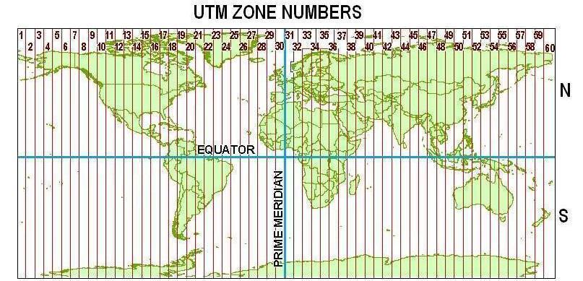
UTM Zones
Interactive Map: https://mangomap.com/robertyoung/maps/69585/what-utm-zone-am-i-in-#
https://earth-info.nga.mil/GandG///coordsys/grids/universal_grid_system.html

Slide 16
Two Main Data Types
Vector Data
Raster Data
Defines geographic data
Point Based Data
Individual Points
Lines
Polygons
Combinations of the above
Defines geospatial data
Matrix Based Data
Each cell of the matrix represents a cell on the earth. The value of the cell is the value of the variable in that cell.
E.G. raster of population density
Requires a definition of a CRS, an origin, and data extent.

Slide 17
Vector Data: File Types
Well Known Text (.wkt)
Keyhold Markup Language (.kml)
Shapefile (.shp)
Created in text editor
Simple and easy to contruct.
Does not contain informat
Created in a software (QGIS)
Preferred file type.
Contain information about
CRS
Extent
Created to be used with Google Earth
Based on XML

Slide 18
RASTER DAta
GeoTIFF
Good Reference on File Types https://gisgeography.com/gis-formats/
Easiest to create in a software.

Slide 19
Data Sources
Humdata.org : https://data.humdata.org/dataset
Good for Population Density Data (from Facebook)
DIVA-GIS: http://diva-gis.org/gdata
Good for Administrative Boundaries data from around the world
GeoNames: https://www.geonames.org/
``eleven million placenames that are available for download free of charge´´

