Slide 1
SAFE Research in Hostile Environments
A Systematic Handbook of Fieldwork Protection and Digital Security in the Social Sciences
Jannis Grimm, Kevin Koehler, Ellen Lust, Ilyas Saliba, and Isabell Schierenbeck

Slide 2
Preparing for the Unknown
Fieldwork Preparation and Risk Assessment for Research in Hostile Environments
Kevin Koehler, Sylvain Lefebvre, Daniel T. R. Masterson, Francesco Strazzari

Slide 3
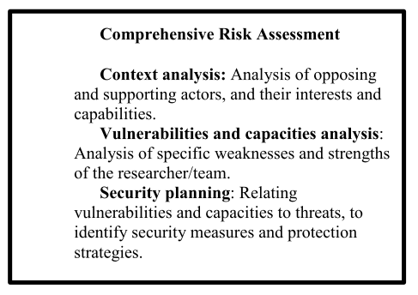
Risks and Threats
What is fieldwork risk?
Learning about risk
Field access and legal frameworks for off-site research (insurance policies, legal requirements, etc.)
Informal procedures concerning the everyday experience of researchers
Risk dependence on individual researchers AND their projects
Types of threats: threat analysis

Slide 4
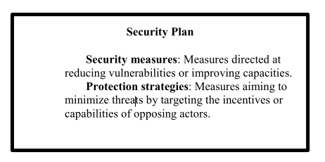
Risk assessment & security planning
Precautions that can be taken to ensure personal safety and the safety of interlocutors in the run-up to a field stay
Security planing
Security measures
Protection strategies
Preparing contingency plans

Slide 5
In the Field
Doing Research in Hostile Environments
Ellen Lust, IIlyas Saliba, Emma Beals, Osama Diab, Alessandra Russo

Slide 6
Re-assessing risks and management strategies while in the field
Considering positionality: who you are, and who people see you as
Making ’mundane’ decisions: housing, office, transportation
Protecting field contacts’ identities and best practices for interacting with interlocutors in hostile environments
Conducting continuous dynamic risk assessment and best practices for more acute crisis-management situations and security-relevant interactions
Practicing ’self-care’

Slide 7
After the Field
Risk Assessment Revisited, Dissemination, Publication, and Emotional Challenges
Isabell Schierenbeck, Florian Kohstall, Sarah Parkinson, and Mara Revkin

Slide 8
Renewed risk assessments, research dissemination, prepublication, and publication, research-related trauma and distress
Keeping in contact with the field, intelligence services and police contact
Anonymisation from a safety perspective, early presentations and workshops, recognizing the contribution of local partners, risks and benifits of publishing
Emotional distress and dilemmas, best practices for sharing fieldwork experiences and coping strategies, debriefing, responsibilities of departments/universities

Slide 9
Field Work in Datafied Societies
Digital Security and Data Protection before, in, and after the Field
Jannis Grimm, Morana Miljanovic, Vasilis Ververis, Kersti Wissenbach

Slide 10
Research in a datafied society
Communication
Data storage
Data collection & processing
Digital threat modeling
Thinking of data holistically
Different research dimensions and their related risks
Communication process
Data collection and processing
Data storage
Strategies for handling digital risks
Slipping through the net
Increasing the costs
Minimising the benefits

Slide 11
Handling digital risks
Mitigation tactics
Protecting communication
Protecting data collection and processing
Browsing safely
Entrapment and Phishing
Protecting data storage
Obfuscation and pseudonyms
Offloading and compartmentalising
Operational security
Managing expectations and the low hanging fruit

Slide 12
Checklists & Appendix
Comprehensive digital security guides
Guides for source protection
Guides for self-protection against online harassment
Guides for reactive mitigation
Guides to specific tools

