Slide 1



4 April 2024
GLD Policy Roundtable

Slide 2
Governance and Local Development Institute
Who are we?

Slide 3
Governance and Local Development Institute
”
”
Who we are.
We aim to promote human welfare by conducting scientifically rigorous research across the globe. Our research focuses on answering a fundamental question: why are some communities able to provide secure environments, good education, adequate healthcare, and other factors that encourage human development, while others fail to do so? We engage with communities across the world, develop methodological tools, gather data, undertake analyses on major issues affecting societies today, and disseminate findings to academics, relevant policy-makers, and the communities in which we work.

Slide 4
Governance and Local Development Institute
Data Access
Research
Educational Material
Scholarly Network
Policy Engagement
What we do.

Slide 5

Governance
and Local
Development
Institute
How you can
engange.

Slide 6

Governance and Local Development Institute
Visit gld.gu.se/en
to learn more!

Slide 7
GLD Policy Roundtable
Gender and Local Politics in the Global South
SPEAKERS

Slide 8

MODERATOR
Allison Sambo
Director of Evaluation & Analytics at
Global Fund for Women
Allison is a researcher and analyst with significant experience in applied, mixed-methods research and evaluation. She has worked in East and West Africa in both academic research and project monitoring and evaluation. She has experience developing and managing monitoring and evaluation systems for social and behavior change programs by UNICEF, UNHCR, USAID and private foundations. Allison received her Masters of International Public Affairs and her PhD in Development Economics from the University of Wisconsin-Madison, with a dissertation on bilateral/multilateral funding for gender equality and empowerment and the efficacy of financing on gender equality and empowerment. Her current work and research focus on measuring social movement capacities, the roles and relationships between social movement actors, and utilization of technologies to map, assess, and support social movements and social movement actors.

Slide 9

Safia Farole
Assistant Professor in the Department of Politics and Global Affairs at Portland State University.
Safia's research interests include local politics, party systems, and elections in Africa. She has published articles in the journals Party Politics, Comparative Politics, Government & Opposition, Global Studies Quarterly, and Comparative Strategy. In the 2022-2023 academic year, she was awarded the Craig Wollner Memorial Award for Junior Faculty, which recognizes excellence in research and teaching by one junior faculty member in the College of Urban and Public Affairs at PSU. In the 2021-2022 academic year, she was the recipient of the American Association of University Women (AAUW) American Post-Doctoral Fellowship. In June 2019, she received her Ph.D. from the University of California at Los Angeles (UCLA).

Slide 10

Marwa Shalaby
Assistant Professor in the Department of Political Science at the University of Wisconsin-Madison.
Shalaby’s research areas are gender politics, authoritarianism, and legislative politics. Her work focuses on the intersection of legislative politics, authoritarianism, and women in politics in the Middle East and North Africa (MENA) region. She currently serves on the editorial boards of Politics and Gender and the Review of Economics and Political Science. Shalaby is also an Associate at Governance and Local Development Institute. Shalaby’s work has appeared or is forthcoming in the American Political Science Review, Journal of Politics, Comparative Political Studies, Politics and Gender, Comparative Politics, Governance; PS: Political Science & Politics, Political Research Quarterly, and Parliamentary Affairs, among others.

Slide 11

Anjali Thomas
Associate Professor in the Sam Nunn School of International Affairs at Georgia Institute of Technology.
Anjali specializes in comparative politics and political economy with a focus on India. The substantive questions that drive her current research have to do with the politics of public service provision, local and multi-level governance, gender disparities, and distributive politics. Anjali is the author of Democratization from Above: The Logic of Local Democracy in the Developing World, published with Cambridge University Press (2016). Her recent articles have been published in The American Journal of Political Science (x2), The British Journal of Political Science, Comparative Political Studies, and Political Research Quarterly. Her major ongoing projects focus on the pathways through which citizens gain formalized access to services and on the role of state actors in shaping citizens’ pro-developmental attitudes and behaviors.

Slide 12
Marwa Shalaby
Assistant Professor in the Department of Political Science at the University of Wisconsin-Madison.

Slide 13
Women’s Participation in Local Politics
Local Government Defined: “institutional units whose fiscal, legislative and executive authority extends over the smallest geographical areas distinguished for administrative and political purposes.”* (SDG indicator 5.5.1b)
UN Representation in Government, Worldwide:
  36% at local level
  25% in national parliaments**
Gender Quotas at Local Level:
  75 countries
  One-third of these are authoritarian (International IDEA 2022).
Gender and Politics in Authoritarian Regimes, important and overlooked:
  Continue to focus on women’s participation in national political processes
  Yet, local politicians most proximate to constituents
* UN Women
** UN Women in Local Government dataset

Slide 14
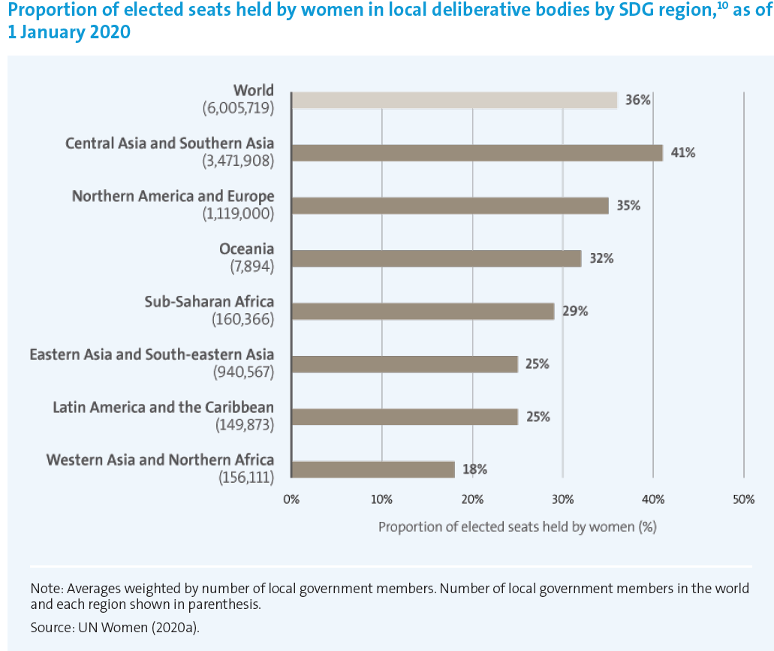
Women’s Local Representation in the MENA
MENA among lowest regions in women's local representation
Women are only represented in local offices in some MENA countries (e.g., Saudi Arabia, Qatar before 2021, PA)
Regional variation in quotas* and representation
  Tunisia has about 48% women in local councils
  4% in Lebanon and 3.5% in Oman
* Reserved seats is the most common type of gender quotas in the MENA

Slide 15
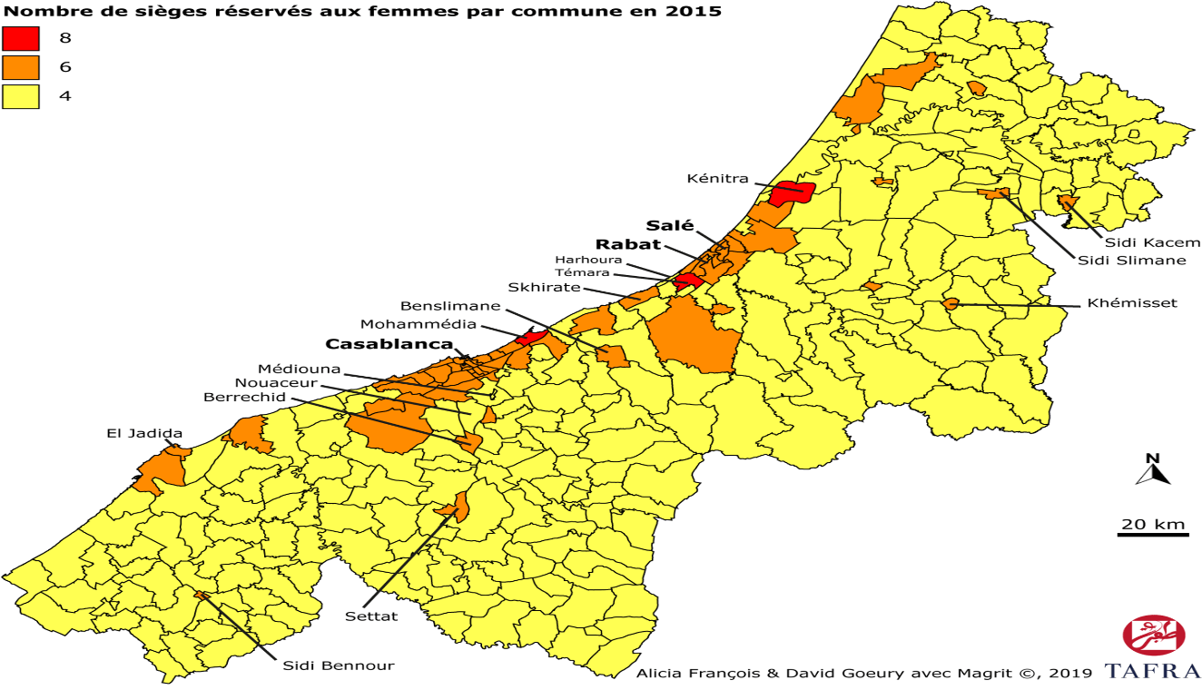
The Case of Morocco*
Gender Quotas in Morocco:
  12% local gender quota in 2009
  30% in 2015
No evidence that party ideology matters
Women have an advantage in districts with Proportional Representation (PR) electoral rules
  more urbanized, economically developed, higher education.
The majoritarian electoral system (SMD) tends to favor males
  Voters view men as more connected and capable service providers
Voters’ demand for services limits women’s success beyond gender quota seats
* Drawn from GLD working paper #48

Slide 16
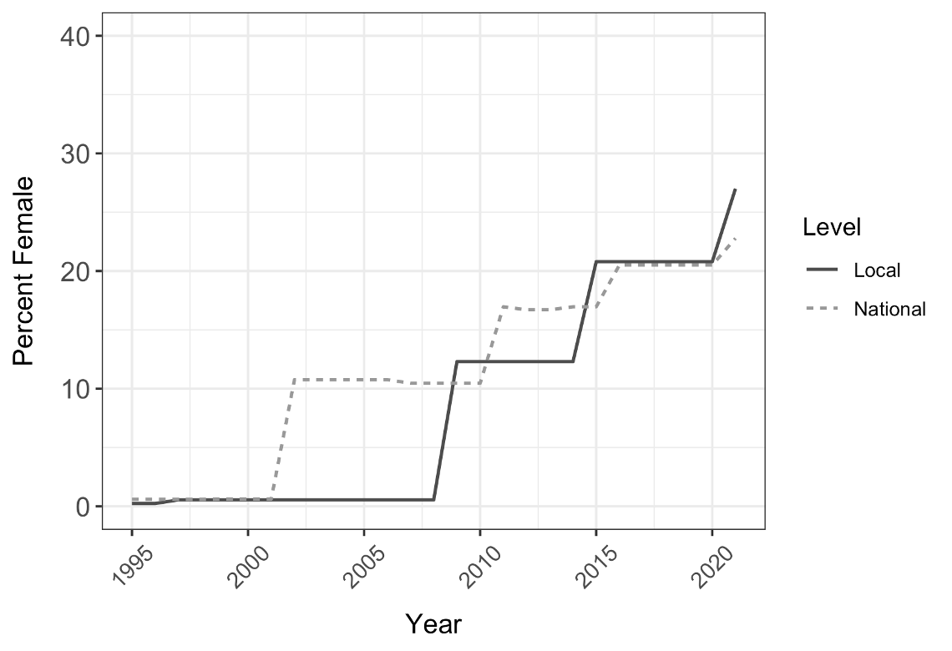
Women’s Representation over time in Morocco on National and Local Levels

Slide 17
Safia Farole
Assistant Professor in the Department of Politics and Global Affairs at Portland State University.

Slide 18
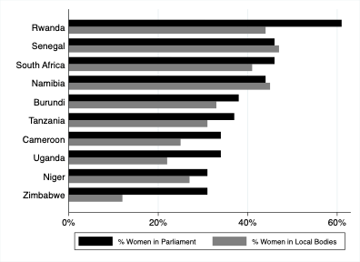
Women’s Representation in National vs. Local Bodies in Sub-Saharan Africa
Women’s representation increased significantly in recent decades
Facilitated by proportional representation (PR) rules and/or gender quotas
Women’s Representation (Median)
  26% at national level
  17% at local level

Slide 19
Local Gender Quotas
Types of Gender Quotas:
  Reserved seats
  Candidate quota with ranking/placement
Quota Percentages: 25% – 50%
Various Electoral Rules used with Quotas:
  Plurality rules (first-past-the-post; used mainly with reserved seats)
  Proportional representation (closed and open lists)
  Mixed electoral systems

Slide 20
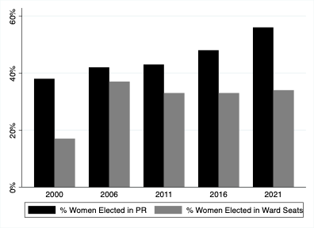
South Africa’s Local Gender Quota
Quotas at Local Level:
  Candidate quota
  Voluntary party quota
African National Congress Party Quotas
  50% parity policy in 2006
  30% gender quota
Local-Level Electoral System:
  Mixed electoral system
  Quota applies only to the PR-lists

Slide 21
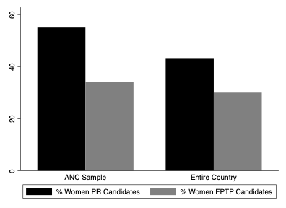
Under-Representation of Women in South Africa: Local Elections with First-Past-the-Post Rules

Slide 22
Main Challenges
Supply-side:
  Party gatekeeper bias
  Electoral rules disadvantage women
  Women’s self-(de)selection
  Gender quota policy design
Demand-side:
  Voter bias
Implication:
  Male domination of executive structures, which makes it difficult for women to set the agenda locally

Slide 23
Anjali Thomas
Associate Professor in the Sam Nunn School of International Affairs at Georgia Institute of Technology.

Slide 24
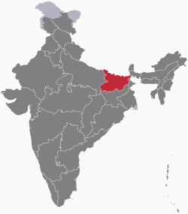
Women’s Political Representation and Participation in India
  Worldwide*: 26.5% women
  Central and Southern Asia*: 19% women
  India
    National Parliament – Lok Sabha – 14% women
      33% seat quota recently introduced in September 2023 legislation
    State Assemblies – range from 0% to 18% women*
    Local Level
      Gender quotas in at least 33% of seats in all states (after 1993 Constitutional Amendment )
      Bihar has 50% at the local level
*Source: https://www.unwomen.org/en/news-stories/feature-story/2023/10/india-passes-law-to-reserve-seats-for-women-legislators

Slide 25
Impact of Local Gender Quotas in India
  Promote developmental and social goods
  Increase women’s local-level representation, even in constituencies not covered by quotas
  Improve citizen attitudes toward local female leaders and break down gender stereotypes
  Increase the number of female activists at the local level
  Mobilize women voters
  Increase promotion, party re-nomination, candidate entry, and electoral success of women in higher levels of government

Slide 26
Do Local Gender Quotas Improve Women’s Electability at Higher Tiers by Shaping Voter Preferences?
Anjali Thomas, Charles Hankla, Sayan Banerjee, and Arindam Banerjee. “Do Local Gender Quotas Improve the Electability of Women at Higher Tiers? Evidence from a Survey Experiment in North India.” GLD Working Paper No. 67.
Local Gender Quotas are “as-if-randomly” assigned
Multi-Level Learning

Slide 27
Do Local Gender Quotas Improve the Electability of Women at Higher Tiers by Shaping Voter Preferences?
Anjali Thomas, Charles Hankla, Sayan Banerjee, and Arindam Banerjee. Do Local Gender Quotas Improve the Electability of Women at Higher Tiers? Evidence from a Survey Experiment in North India. GLD Working Paper No. 67.
Multi-Level Backlash Mechanism (Amongst Partially Progressive Men)

Slide 28
Political Party Ideology and Ethnonationalist Gender Norms
Thomas, A., Banerjee, S., Hankla, C. and Banerjee, A. (2024), “Ethnonationalist Gender Norms: How Parties Shape Voter Attitudes toward Female Candidates in India.” American Journal of Political Science. https://doi.org/10.1111/ajps.12788
“Ethnonationalist Gender Norms”
patriarchal norms associated with an ethnonationalist party’s ideology
targeted toward women in party’s core ethnic constituency.
Conclusion:
Upper-caste women affiliated with the BJP disadvantaged by party’s ethnonationalist gender norms

Slide 29
Panel Discussion

Slide 30
Q&A
In the Q&A box, share any questions you may have for the panelists

Slide 31
4 April 2024
GLD Policy Roundtable

